Slide 1
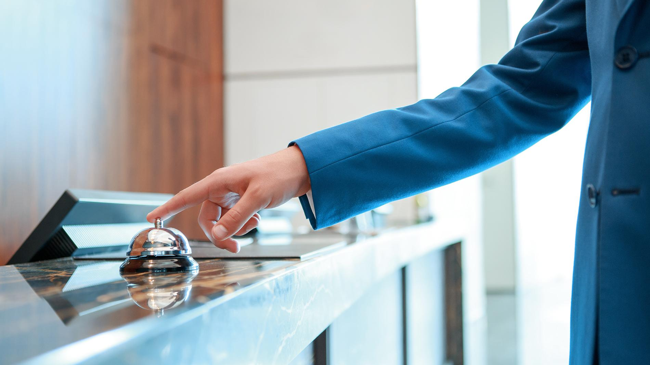
MODERN SLAVERY AND HUMAN TRAFFICKING IN THE HOSPITALITY SECTOR
Notes:
Notes for Trainer:
Introduce the awareness training.
Ask everyone to introduce themselves - name and job role.

Slide 2
Objectives
By the end of this session you will:
1
2
3
4
Understand what modern slavery and human trafficking are and their impact on the hospitality industry.
Understand the global and UK context of modern slavery.
Understand some of the signs of the different types of modern slavery that could occur.
Understand your own responsibility in tackling modern slavery and what procedures to follow if you encounter an incident.
Notes:
Notes to Trainer:
Explain the objectives of the training (as on slide).
Provide some context to the training: “Not everyone checking into our hotel is a trafficker, not every child is being exploited, but, if you see something suspicious, something odd, something out of kilter then report it using the procedures which will be outlined through this workshop.”
Provide ground rules:
Create a safe environment, “feel free to share and be respectful of what others say”
Participation is encouraged
If anyone feels upset or distressed by the content of this workshop, they can leave the room.

Slide 3
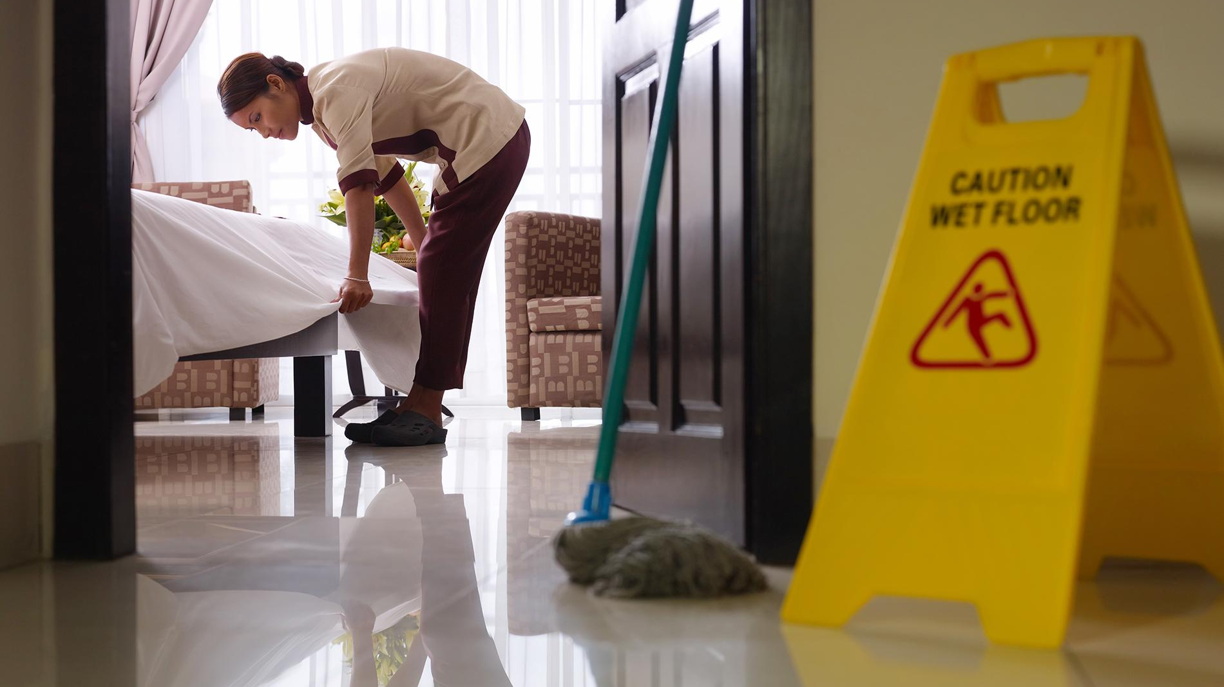
What is your understanding of the term modern slavery?
Notes:
Notes to Trainer:
Ask everyone to write on the post-its provided:
Ask some to feedback and discuss.

Slide 4
Modern slavery
Debt bondage
Labour exploitation
Human trafficking
Sexual exploitation
Criminal exploitation
Forced begging
Removal/selling of organs
Forced marriage
Illegal adoption
Modern slavery
Hospitality is a high-risk industry for labour
exploitation and sexual exploitation
Notes:
Notes to Trainer:
Explain what modern slavery is: modern slavery is an umbrella term that was adopted by the UK Government in 2015 to coordinate the prevention and prosecution of four crimes: slavery, human trafficking, forced labour, and domestic servitude.
All incidents of modern slavery include two basic elements (1) the deception or coercion of an individual (2) for the purpose of exploitation.
Human Trafficking: the movement of people by means such as force, fraud, coercion or deception with the aim of exploiting them.
Forced labour: ls work or service that is extracted from any person under the threat of penalty and for which the employee has not offered himself voluntarily
Explain that modern slavery and human trafficking can often be used interchangeably, which can be confusing. Commonly, human trafficking must entail some movement or travel, whereas modern slavery does not require this. This training will refer to modern slavery to refer to both terms.

Slide 5
Modern slavery
Modern slavery is a growing issue, which affects men, women and children.
It is an international crime with an estimated 40.3 million people living in conditions of slavery around the world.
In the UK for example, the National Crime Agency recorded an actual figure of 10.267 potential victims of human trafficking in 2019.
A 52% increase on 2018 figures.
2020 saw a drop in reporting due to COVID-19.
HOWEVER, the Centre for Social Justice estimates that there could be up to 100,000 potential victims of modern slavery in the UK.
Notes:
Go through slide
COVID-19 has increased the hidden nature of the crime because more people were in doors and therefore not spotting incidents as regularly.
The most common type of exploitation in the UK is labour exploitation (52% of adult cases and 63% of child cases in 2018) - https://assets.publishing.service.gov.uk/government/uploads/system/uploads/attachment_data/file/840059/Modern_Slavery_Report_2019.pdf

Slide 6
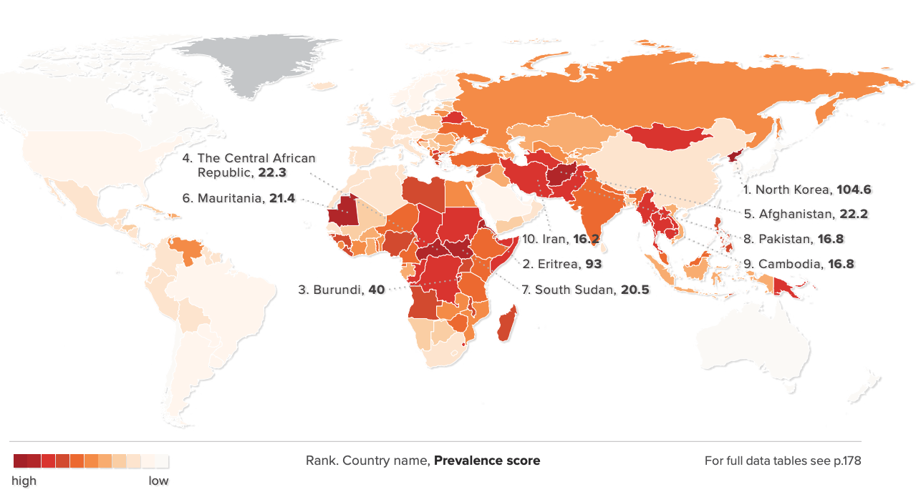
Modern Slavery around the world
Notes:
Notes for Trainer:
This map is from the Global Slavery Index 2018 and details the prevalence of modern slavery according to the top countries.
Extra information on modern slavery globally:
The International Labour Organisation (ILO) estimates that there are around 24.9 million people around the world in forced labour - http://www.alliance87.org/2017ge/modernslavery#!section=10
4.8 million people are forced into sexual exploitation

Slide 7
Modern slavery in the hospitality sector
The hospitality sector provides 292 million jobs globally (that’s 1 in every 10 jobs)
It has been identified as ‘high risk’ of modern slavery for a number of reasons:
Complex operating models breed a lack of accountability for worker welfare.
Market pressures lead to unfair employment practices.
The high proportion of low-skilled jobs attracts more vulnerable workers.
Sexual exploitation is an additional risk in the sector, especially for hotels, who may be unwitting hosts to traffickers using their rooms for exploitation.
A total of 115,140 victims of trafficking in the European hospitality industry annually!
Notes:
Notes for Trainer:
292 million jobs statistic is from World Tourism Council.
115,140 victims of trafficking statistic is from COMBAT THB research conducted in 2014:
93,480 victims of sex trafficking in hotels
14,820 victims of forced labour in restaurant and bars
6,840 victims of forced labour in hotels
Reasons for risk levels:
There is a high reliance on subcontractors and agency labour which makes employment relationships less clear; the industry is heavily franchised and there may be little interaction between brand, owner, operator; the is minimal regulatory oversight. This results in worker welfare being ignored.
This is a labour intensive industry with seasonal fluctuations in labour requirements. This results in reduced wages and increased contract flexibility (e.g. many workers are set up as “self-employed”, 19% of the industry are on zero-hour contracts, there is chronic underpayment of national minimum wage and only 3.3% of workers are members of a union).
Low-skilled jobs often involve long hours and high competition. Shift/night work is common. As is temporary and part-time work. A lot of work is done by women and migrants who face vulnerabilities to modern slavery.
Source: https://shivafoundation.org.uk/hospitality-a-high-risk-industry-for-labour-exploitation/

Slide 8
Modern slavery in the hospitality sector
Modern slavery can impact a hospitality business in a variety of ways:
Exploitation of your workers
Sexual exploitation and domestic servitude of guests
Exploitation within your supply chain
Notes:
Notes to Trainer:
Explain the main ways the hospitality industry is vulnerable to risk of modern slavery.
Staff, in particular those recruited or subcontracted via unscrupulous agencies, can be victims of bonded or forced labour.
For hotels: Their use can be for sexual exploitation of children and adults and domestic servitude.
Products and services supplied to the business might be produced by forced or bonded labour, labour exploitation and unethical labour practices.

Slide 9
How does modern slavery occur?
Charging recruitment fees
Retention of Identification Documents
Worker living conditions
Contract deception
Wages and benefits
Continuum of exploitation
Long hours
Non NMW payment
No payment
Threat or violence
Notes:
Noes to Trainer:
Add further detail to each of the ways modern slavery can manifest:
Charging a recruitment fee: Workers (especially migrant workers) are asked to pay fees to agencies and brokers for recruitment and placement in jobs abroad. These fees may cover costs including the recruitment itself, travel, visa and administrative costs, and often other unspecified ‘fees’ and ‘service charges’. These fees are often substantial and are sometimes set up as loans with high rates of compound interest. (The Institute for Human Rights and Business (IHRB))
Contract deception: This indicator conveys false promises about the hours and/or number of days to be worked and/or the working environment (ILO)
Wages and benefits: This indicator reveals the nature of deception concerning the right to keep to wages and/or the amount that the individual is paid. It also includes excessive deductions of wages for food or lodgings, or monetary penalties for fraudulent reasons. (ILO)
Retention of ID documents: Coercion at the point of recruitment, transfer, or transportation through the means of confiscation of documents relating to both identity and/ or travel documents (ILO)
Worker living conditions: It includes that the individual was deceived about his/her freedom to choose the location, type of lodgings or deceived to the quality of the lodgings, in particular the lack of privacy. It also includes the lack of access to health care (ILO)
Exploitation happens on a continuum – it accounts for all situations that stray from “decent work”, from labour market infringements and abuse all the way to more sever forms of exploitation. It’s important to be aware of all types of exploitation as it can be an indicator of something more severe taking place.

Slide 10
Who are the victims?
Anyone can be a victim of modern slavery. However, there are some factors that put people at increased risk.
Migration status
Social network
Language
Homelessness
Gender
Notes:
Notes to Trainer:
The main point is that anyone can be a victim. There are some factors that put people at increased risk.
Migrants: Migrants that do not know their rights are less likely to call out discrimination in pay or working conditions. Undocumented workers can have their migration status used against them to force them into poor working conditions. But it is not only migrants who are exploited. One of the top three nationalities of victims in the UK is British.
Language: Workers that do not speak English are vulnerable as it is difficult for them to access support, ask for help, or learn about their rights.
Homelessness: Rough sleepers and homeless people are often targeted by exploiters who offer them false working opportunities, trapping them in exploitation.
Social network: Workers who do have a social net (like migrant workers) are more vulnerable as they are forced to rely entirely on their exploiters to fulfil their basic needs such as food and accommodation.
Sex: women and girls make up the overwhelming majority of victims of sexual exploitation.
Additional considerations:
Many don’t consider themselves a victim of a crime.
Many are unwilling or afraid to seek help. They may not be aware of their rights.
They fear going to the authorities and may think their migration status is at risk.
They can develop an attachment to their traffickers
Traffickers can develop victim dependency on drugs or alcohol which they supply.
There is also no such thing as a typical trafficker. They can be known to the victim. They can be men or women.

Slide 11
Raising awareness of modern slavery:
Staff
It is important to be aware of some of the signs that could indicate modern slavery amongst our fellow staff members:
They may appear unkempt, malnourished dirty. There could be signs of physical abuse.
They may not seem to have possession of their identification documents.
The worker doesn’t have a personal bank account or a group of staff all have the same bank account.
Their behaviour may be withdrawn or appear frightened; they don’t speak for themselves, rarely interact with other colleagues and refuse help when offered.
They might travel at unusual times or always with the same group of workers, even if they don’t appear to be friends.
Notes:
Notes to Trainer:
These are some of the signs of trafficking with respect to fellow staff members. Ask the participants to suggest other signs.
You can find a full list of indicators here: http://shivafoundation.org.uk/wp-content/uploads/2020/02/18_SF_SSB_Sec05_Indicator-List.pdf
Read out the Combat case study: Osama (Found here http://shivafoundation.org.uk/wp-content/uploads/2020/02/17_SF_SSB_Sec05_Case-Studies.pdf -- case study 3).
Ask the group their thoughts and if they knew about this case in Scotland.

Slide 12
Raising awareness of modern slavery:
Staff
Case study: Karla
Notes:
Read out Karla’s story (see Combat Case Study: see here http://shivafoundation.org.uk/wp-content/uploads/2020/02/17_SF_SSB_Sec05_Case-Studies.pdf – case study 1).
At end:
Q: What were the indicators in Karla’s story?
Team to call out any indicators they noticed.

Slide 13
Raising awareness of modern slavery:
Staff: Karla’s Story
Indicators
Controls
Fake CV and references
Fake address and bank account
Arrives at work alone
Dropped off and picked up from the same location
Isolated and unwilling to socialise with colleagues
Volunteers to work during social functions
Works as much overtime as possible
Cash handling or financial irregularities
HR procedures: written reference check
HR procedures: the system alerts of this
Team members can be aware of this
Have a ‘buddy’ system to encourage interaction
Have a fair system, to track engagement
Working time directive limits hours worked
Daily and monthly departmental financial checks
Notes:
Notes to Trainer:
Businesses can put controls in place to ensure any risk factors are mitigated. Go through Karla’s story and demonstrate what controls are appropriate for each indicator.
Go through the slide.
Additional points:
Ensure contracts are given to workers before they begin in a language they understand covering working hours, pay/overtime rates, deductions, holidy and sick pay and accommodation arrangements, if necessary.
Use posters to educate workers of their rights and also the signs of modern slavery.
Share information about their right to freedom of association.
Have grievance and whistleblowing procedures that are shared with workers.
Only use a professional interpreter if one is needed.
Do internal checks (e.g. payroll to ensure bank accounts are distinct and wage payments are correct) but also have conversations with workers and ensure no one is withholding their pay, controlling them, keeping their documents, etc.

Slide 14
Raising awareness of modern slavery:
Agency staff
It is important that the same standard is ensured for agency staff:
Labour providers, employment agencies and onsite service suppliers should uphold the same standards as your company.
If an agency’s price seems too good to be true, it probably is.
Ask the agency what their policies and procedures are in terms of worker welfare.
Do periodic checks of agency worker documentation and payslips.
Check wage, hours, deductions, holiday pay and sick pay, and optional services.
Notes:
Notes to Trainer:
There are steps you can take as a business to ensure all workers are treated well.
Ask to see the agency’s policies: ensure they don’t charge a fee to workers for finding them work, that they have grievance and whistleblowing mechanisms, that they provide workers with contracts in their native language before they take up their role.
When checking with workers, you’re trying to identify if their documents are correct and if they have access to them; you can check payslips to ensure workers are being paid the correct rate and for the correct number of hours.
By checking optional services, you can see if the workers are paying deductions for anything (e.g. accommodation) and whether they’ve agreed to them. You can also identify if there is an unknown third-party controlling the workers, pay and

Slide 15
Raising awareness of modern slavery:
Guests (hotels)
We need to be aware of some of the signs that could indicate sexual exploitation among guests:
A teenage girl uses cash to rent a room with an older man.
A person appears submissive to the person they’re accompanying; they don’t speak for themselves or their ID is held by the other person.
Guests make a last minute booking and have limited or no luggage.
Do Not Disturb sign is kept on the door for a number of days.
A guest makes an odd room request, like a room overlooking the car park or next door to a fire exit.
Notes:
Notes to Trainer:
These are some of the signs of trafficking with respect to guests. Ask the participants to suggest other signs.

Slide 16
Raising Awareness
Notes:
Notes to Trainer:
Before playing the video (embedded), explain that this is actual CCTV footage from an incident in Derby in 2010. Participants are expected to watch the video and explain what indicators came to mind.
Play video and ask the group to feedback on what they noticed.
Example indicators:
Older man + 2 young girls
Young girl has a toy and goes away from the area while the other stands by the man
They have no luggage and it is nighttime
Explain the case: “The man (aged 54) took the girls out for the day, he bought gifts for the girls, the older girl was bought an ipod, the younger girl a cuddly toy. The girls don’t look distressed, they don’t cry, they’ve just been bought gifts, they don’t know what is going to happen. This CCTV clip was shown at the trial and was instrumental in the conviction of this criminal.”
Handout the indicator list and go through it as a group.
Our procedures have been set up so that one indicator doesn’t automatically mean a call to the police. Once one indicator has been reported, then senior managers and other team members will be more alert and will check to see if there are any more indicators. If 3 indicators are observed (or whatever threshold is agreed internally) then our reporting procedure will begin.

Slide 17
Notes:
Notes to Trainer:
Before playing the video explain that it is short film published in August 2015. It is fairly hard hitting and has been primarily made for the hotel industry to raise awareness about child sexual exploitation and trafficking. Remind everyone that if anyone feels distressed at any point, they can step out of the training or do whatever they need and to let one of the trainers know.
Play movie - https://www.youtube.com/watch?v=ezcpO-VApgE
Ask the group if they have any questions or if they recognise any of what is happening in the video from their own experience.

Slide 18
Guests (hotels)
Checking awareness of indicators:
Odd room request, next to a fire escape.
Paid by cash and with limited ID. No use of credit cards.
Young person checking in with older persons or with adults that are boyfriends / girlfriends but much older.
Behaviour of accompanying person was submissive, didn’t speak, sat away from the desk, subdued
Arrived with more than one accompanying adult – one adult then broke away so not to be seen.
Limited Luggage or lack of luggage
Notes:
Notes to Trainer:
This next session is to see what has been learned over the course of the training so far.
Ask the group to think back to the ‘Do you see me?’ 15 minute short film. During check-in alone, ask the group how many indicators they spotted. Allow a short discussion and then reveal the answers on the slide.
There are actually 6 indicators within 2 short minutes
Odd request for a room – next to fire escape
Pay by cash with ID
Young people with boyfriends / girlfriends who seem much older
Behaviour of accompanying person was submissive, didn’t speak, sat away from the desk, subdued
Limited or lack of luggage
Arrived with more than one accompanying adult that then broke away

Slide 19
Guests (hotels)
Checking awareness of indicators:
We should also be aware of some of the signs that could indicate domestic servitude:
Someone living with and working for a family that might be staying in the hotel.
Their passports or other identity documents are being withheld.
The domestic worker doesn’t eat with the rest of the family.
They may appear malnourished and/or unkempt. They may display signs of abuse.
There is evidence that there isn’t enough sleeping space or beds in the room to accommodate the family and the domestic worker.
Their activities and actions are severely restricted and controlled by the employer.
Notes:
Notes to Trainer:
It is important to remember that other forms of modern slavery can take place on a hotel premises, such as domestic servitude. Ensure that everyone understands what domestic servitude is:
Domestic work is a sector which is particularly vulnerable to exploitation and domestic slavery because of the unique circumstances of working inside a private household combined with a lack of legal protection. For some domestic workers, the circumstances and conditions of their work amount to slavery. This happens when employers stop domestic workers from leaving the house, don’t pay wages, use violence or threats, withhold their identity documents, limit their contact with family and force them to work. When families visit hotels, there have been cases where the domestic workers accompanying them were in fact in situations of slavery.
Then go through some of the indicators:
- Someone living and working for a family staying in the hotel. - Not eating with the rest of the family / appearing malnourished. - Not having sufficient sleeping space for family members and staff. - Being forced to work excessive hours. - Not allowed to do anything without the employer.

Slide 20
Guests (hotels)
Checking awareness of indicators:
Case study: Estella and Angelica
Indicators
Passports being withheld.
Restricted movement as not leaving the room and not seen in other areas of the hotel.
How did they appear to the housekeeper? Signs of isolation, anxiety, abuse or maltreatment?
Unable to contact their families.
What signs could the room have potentially shown? Lack of beds?
Disclosure.
Notes:
Break the attendees into small groups and have them read and discuss the Combat Case Study: Estella and Angelica (see here: http://shivafoundation.org.uk/wp-content/uploads/2020/02/17_SF_SSB_Sec05_Case-Studies.pdf - case study 2)
Ask them to consider indicators which might have been spotted in this story?
Team to call out any indicators they suggested. Put the indicators up on the slide.
Q: What would you do if you were the housekeeper in this situation?
Note: This case resulted in the housekeeping staff telling the General Manager who wanted to keep the incident quiet, but the staff reported it regardless. The General Manager was eventually fired and couldn’t find another job in a hotel.

Slide 21
Raising awareness of modern slavery:
Notes:
Notes to Trainer:
Play the video –
How to prevent exploitation in your supply chain- Fair Work Government of Australia (2018)
https://www.youtube.com/watch?v=-wHf1SkYSQQ
Mention that legal responsibility toward outsourced labour changes from one country to the other

Slide 22
Raising awareness of modern slavery:
Supply chain
There are steps you can take to mitigate risk of modern slavery in your supply chains:
Manage your supplier data (who are your suppliers and how much do you spend on them).
Prioritise your engagement. Consider if there are any that are “high risk” and start working with them.
Continuous improvement. This is an ongoing process you’re going through together. Communicate the standard you expect and work together on getting there.
Audit suppliers to ensure they are working towards that agreed standard.
Notes:
Notes to Trainer:
This slide is to inform staff what work can be done to work with suppliers ensuring standards are upheld.

Slide 23
What to do if you suspect modern slavery
Tips for establishing reporting protocols:
Set up grievance mechanisms and whistleblowing procedures for workers.
Establish relationships with police and victim service providers BEFORE an incident.
Appoint Special Points of Contact or Anti-Slavery Champions.
Not all indicators will have the same weight. Determine the threshold for when indicators require further action.
Keep protocols clear and simple to follow.
Remember that the safety of the victim is paramount.
Ensure ALL staff are aware of the reporting protocols and procedures.
Notes:
Notes to Trainer:
Tips to keep in mind.
Anti-slavery champions are those who can monitor the various indicators coming in and can escalate when the situation reaches the pre-determined threshold for it to be an “incident”
They can then call the police/victim service provider and liaise accordingly.
It’s suggested that all staff receive training with information on indicators and reporting protocols as part of their induction.

Slide 24
What to do if you suspect modern slavery
1.
Staff Member witnesses an indicator of possible modern slavery.
2.
Anti-Slavery Champion / duty manager continues to observe the situation.
3.
Anti-Slavery Champion / duty manager / crisis team enacts the incident management process.
4.
Anti-Slavery Champion / duty manager follows up with the staff member who first reported the indicator.
5.
Crisis team informs head office and other relevant contacts.
Notes:
Notes to Trainer:
Take the group through the incident reporting pathway:
If you suspect something odd is going on, and it could be modern slavery then report it to the senior manager on duty/anti-slavery champion.
Once the senior manager on duty/anti-slavery champion thinks there are sufficient indicators observed, they enact the protocols.
Follow internally agreed processes:
The victims should be moved to a safe space if possible
The Modern Slavery Helpline and police should be called (call 999 if there is imminent risk of danger for the victim)
Follow your organisation’s internal crisis reporting processes
The senior manager on duty or anti-slavery champion should follow up with the reporting worker to ensure their wellbeing
Continue with internal reporting as appropriate

Slide 25
What to do if someone discloses modern slavery
Listen carefully and nonjudgmentally.
Provide reassurance and look after welfare.
Protect identify of suspected victim and person reporting.
Explain you will have to tell someone who can help protect the victim.
If victim or witness are in immediate danger, call the police. Ensure safety.
Call Modern Slavery Helpline for suspicions
(08000 121 700).
Only use professional interpreters and not a friend or colleague.
Respect the wishes of the victim.
Ensure staff know how to make anonymous reports (i.e. whistleblowing).
Notes:
Notes to Trainer:
Be aware that victims might disclose their own exploitation. This is not likely to happen often, but if it were to staff should be confident on how to respond.
Read out the tips on the slide. It’s not your job to investigate, just to listen, reassure and follow your company’s reporting protocols. Don’t press the victim for more information than they’re willing to provide. Keep a record of what was discussed.

Slide 26
MODERN SLAVERY AND HUMAN TRAFFICKING IN THE HOSPITALITY SECTOR
Notes:
Notes to Trainer:
Review the post-its from the beginning and re-check understanding of modern slavery.
Ask if there are any questions.
Hand out evaluations and thank everyone for their participation.

